Slide 1
The Banking Management System
Made by: Satvik Sharma (1910991257)

Slide 2
Maintaining lots of data about user info and transaction history
Writing and Maintaining Lots of Information about the users on a paper is a very difficult task. This process is also very slow. It has security , scalability , maintainability etc many issues. This also require a lot of work force . Which Increase cost of a company.

Slide 3
TO this problem i come up with a solution named as
banking management system
Let’s start with the first set of slides
This system provides users a interactive interface to create account ,do transactions and update information. The system is very fast and safe.A users info can only be seen by the user or the admin.The maintainability of the system is very easy.

Slide 4
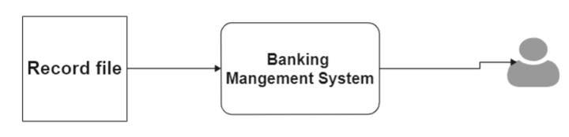
Working
My system is fetching and updating the users information from record file and showing to the user.

Slide 5
The programing language used to make the system is C .This program is using file handling in c to store and update the information.In the starting in the main menu user is having different option to choose like create account,show account,update info,apply for locker and deleting account.
During creating bank account our system ask for users new account number then search in record file if it is not already taken by someone. If it is available then system ask for info about user.
Like creating in all other steps our system opens the record file with appropriate mode and store or retrieve or update the data in record file.
For exiting our function calls exit(0) to end the program.

Slide 6
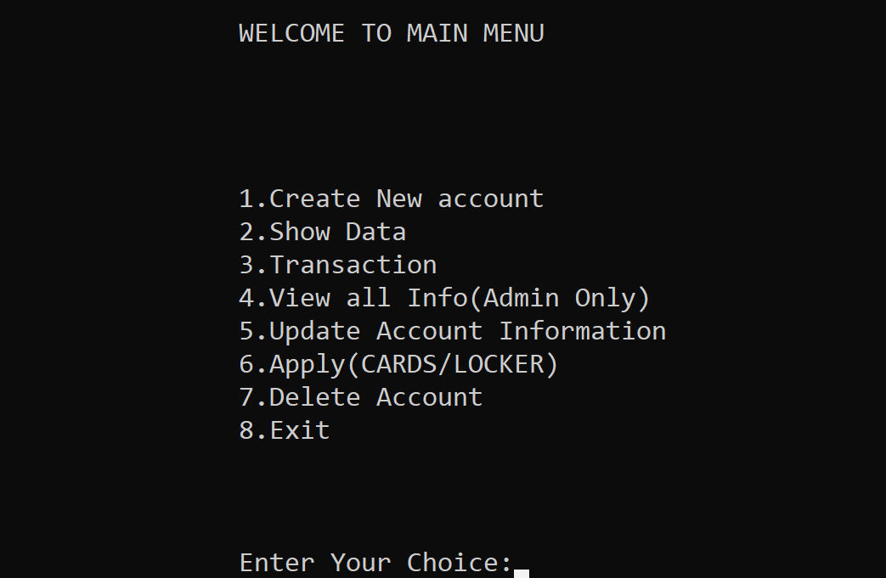
Demo

Slide 7
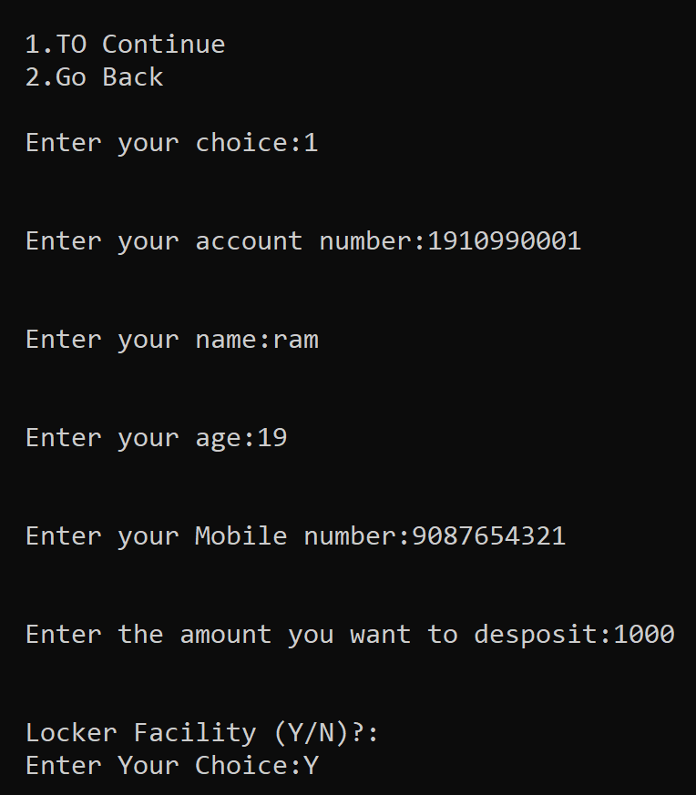
Creating new account

Slide 8
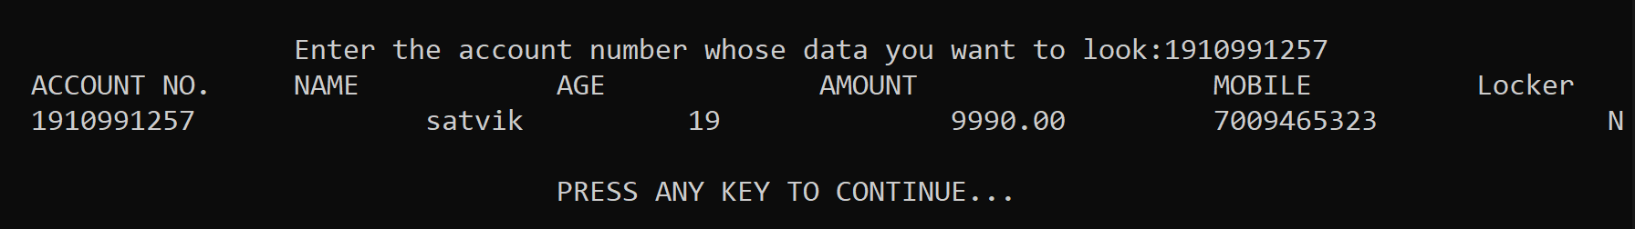
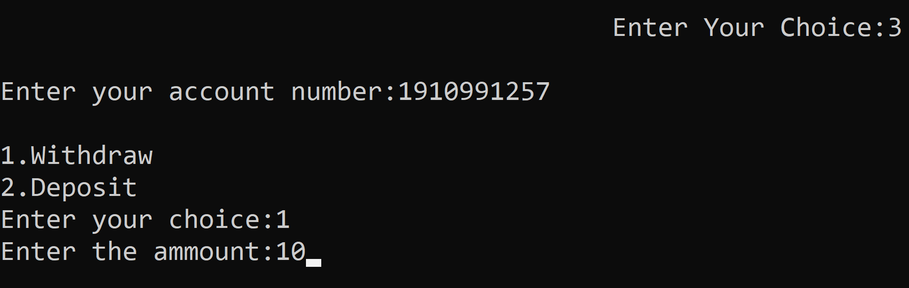
2. SHOWING DATA
3. TRANSACTION

Slide 9
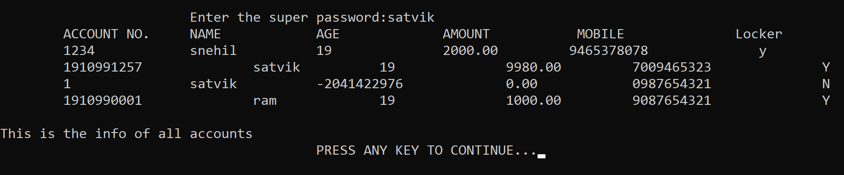
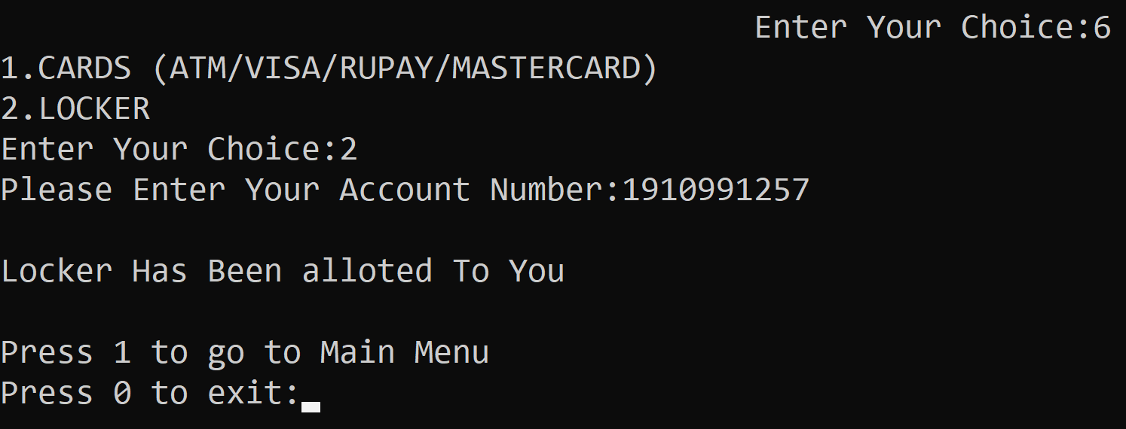
4. View ALL INFO(ADMIN ONLY)
6.Apply Locker or card

Slide 10
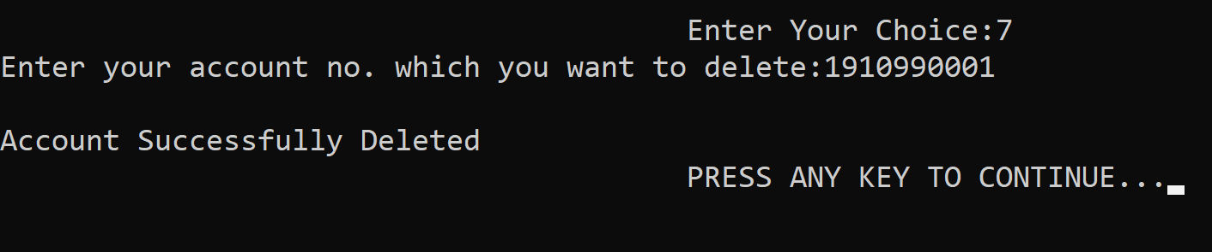
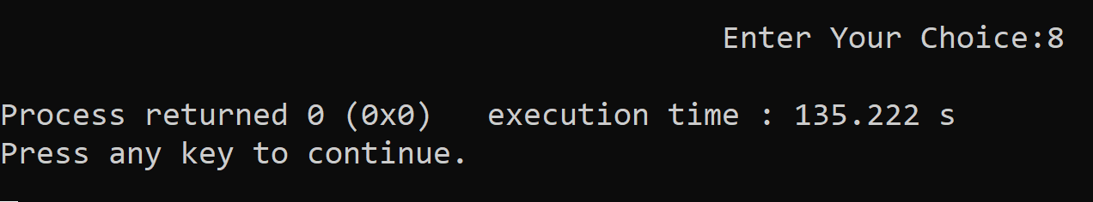
7. Delete account
8.exit

